Slide 1


Slide 2






Explore
Enrich
Invent your SoundTrek

Slide 3





Playlists That Serve You

Slide 4













Technologies Used

Slide 5

Live Demo

Slide 6




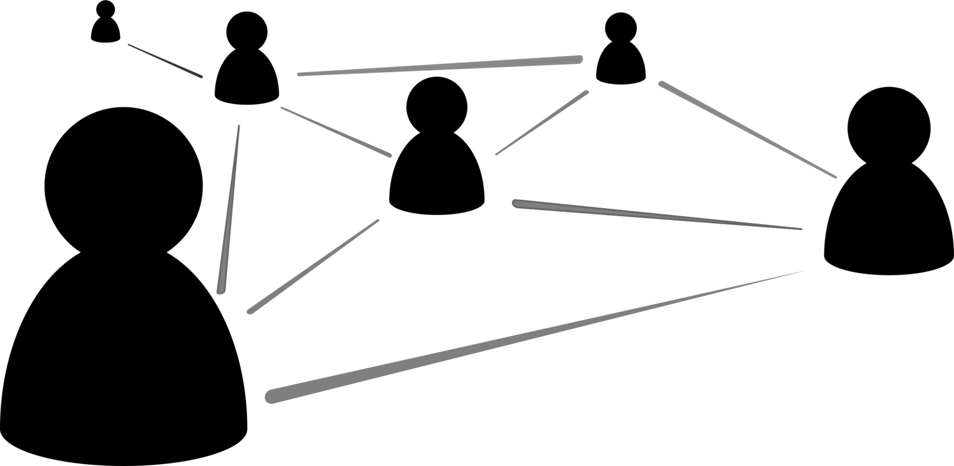
Future Goals

Slide 7
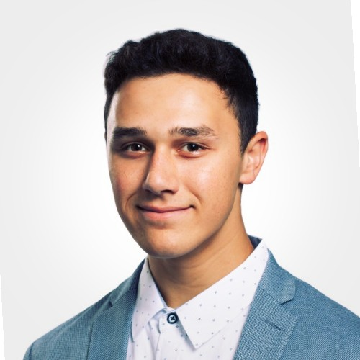
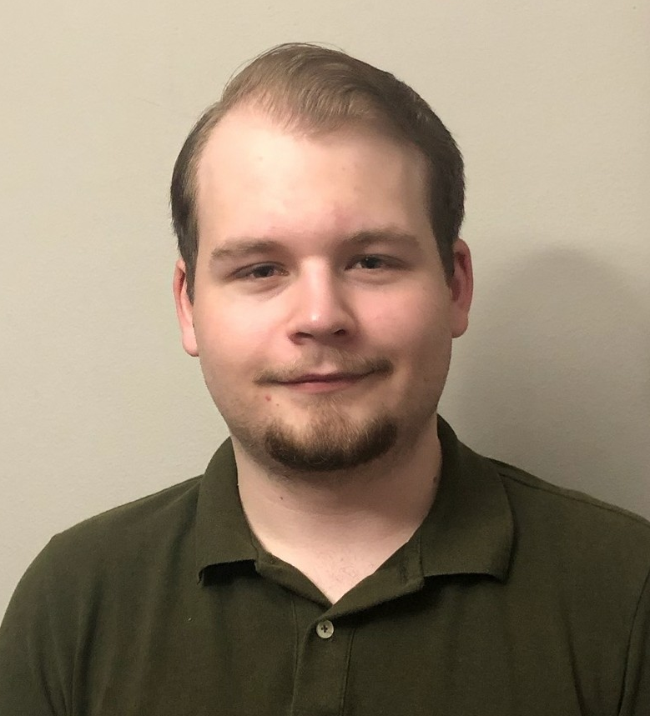
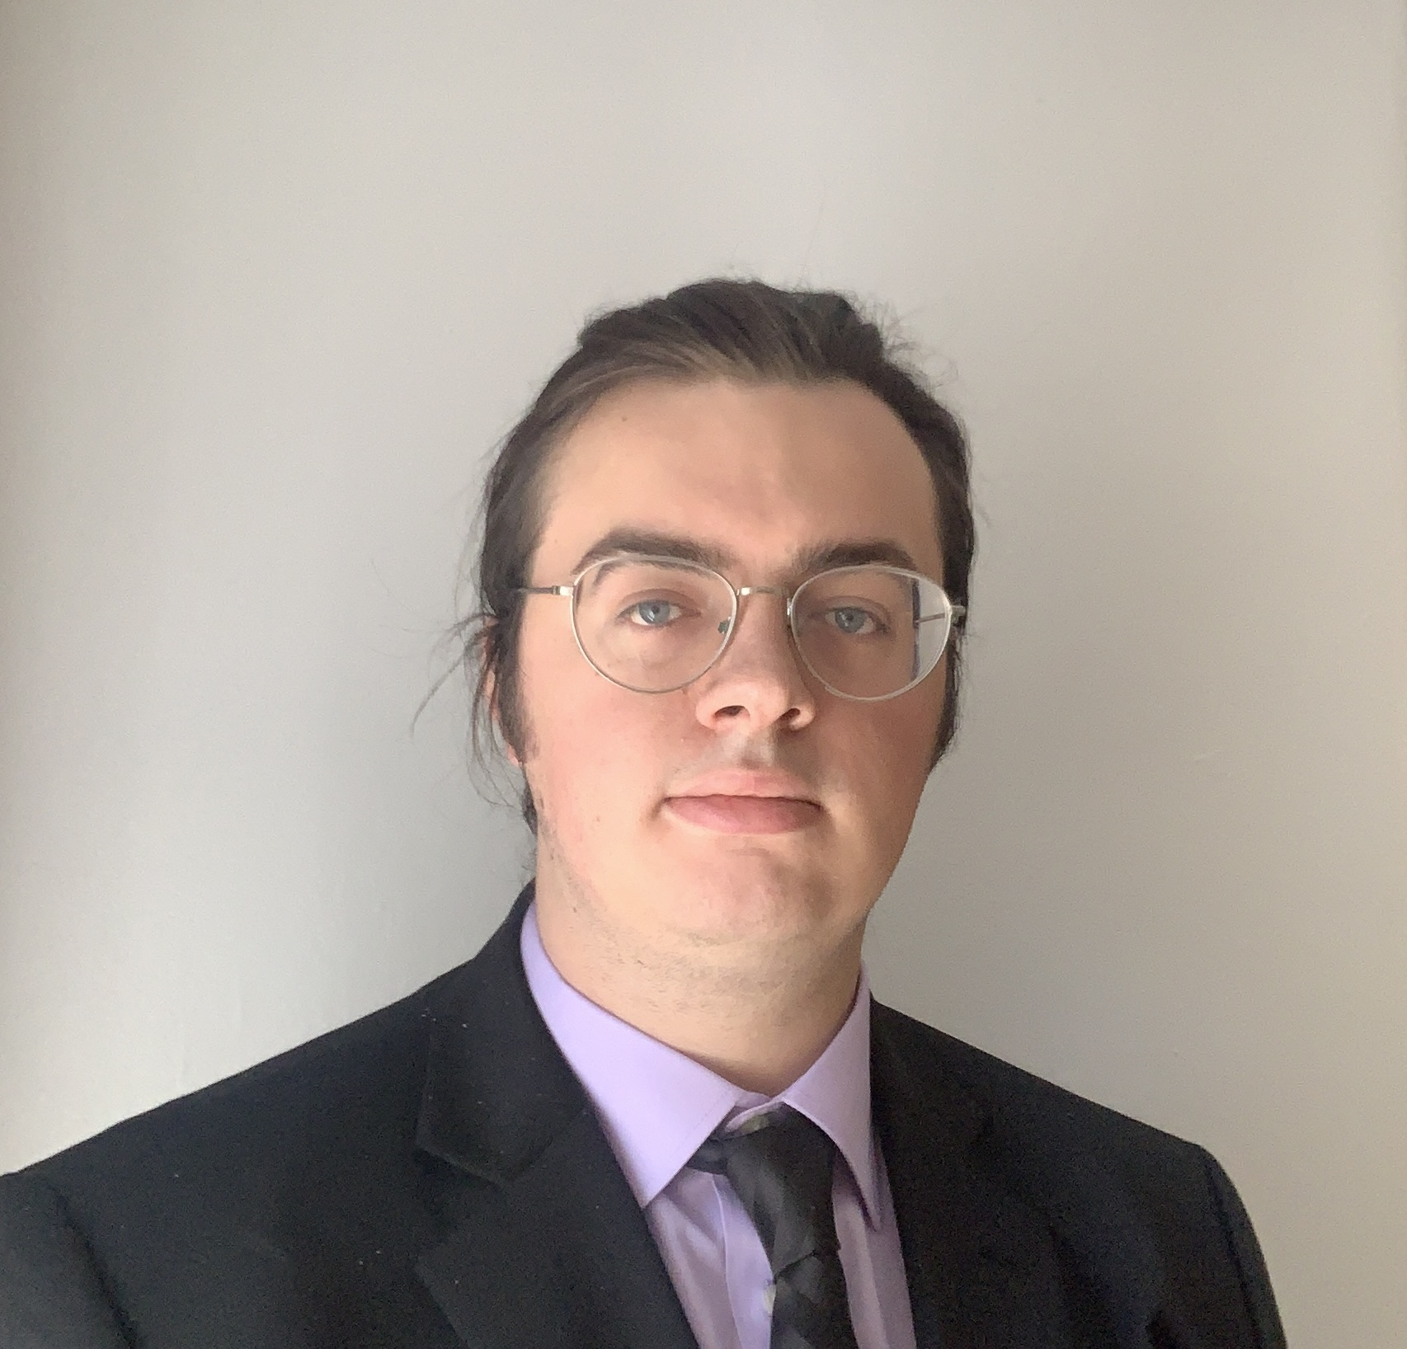
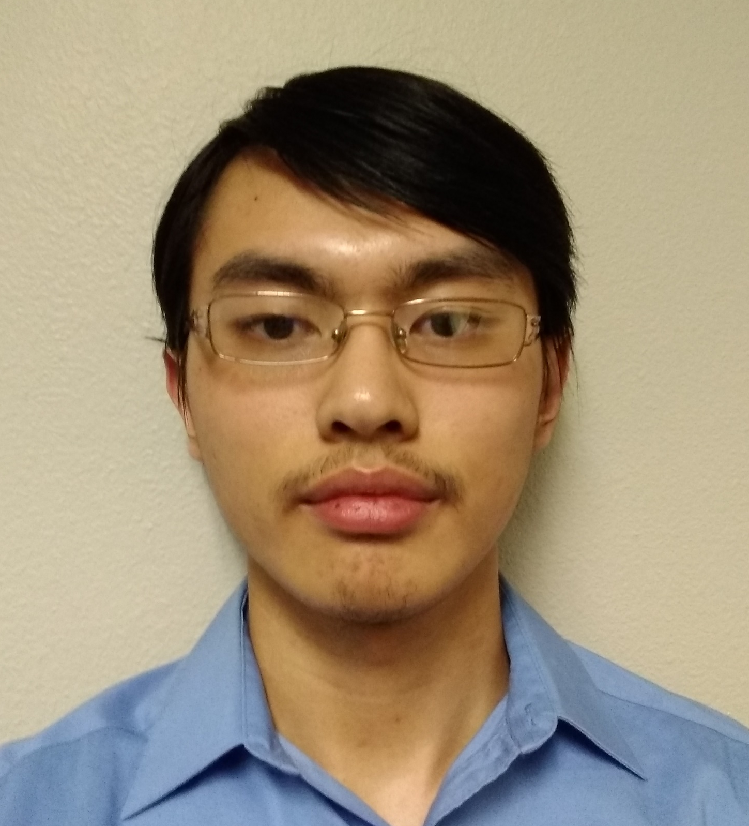
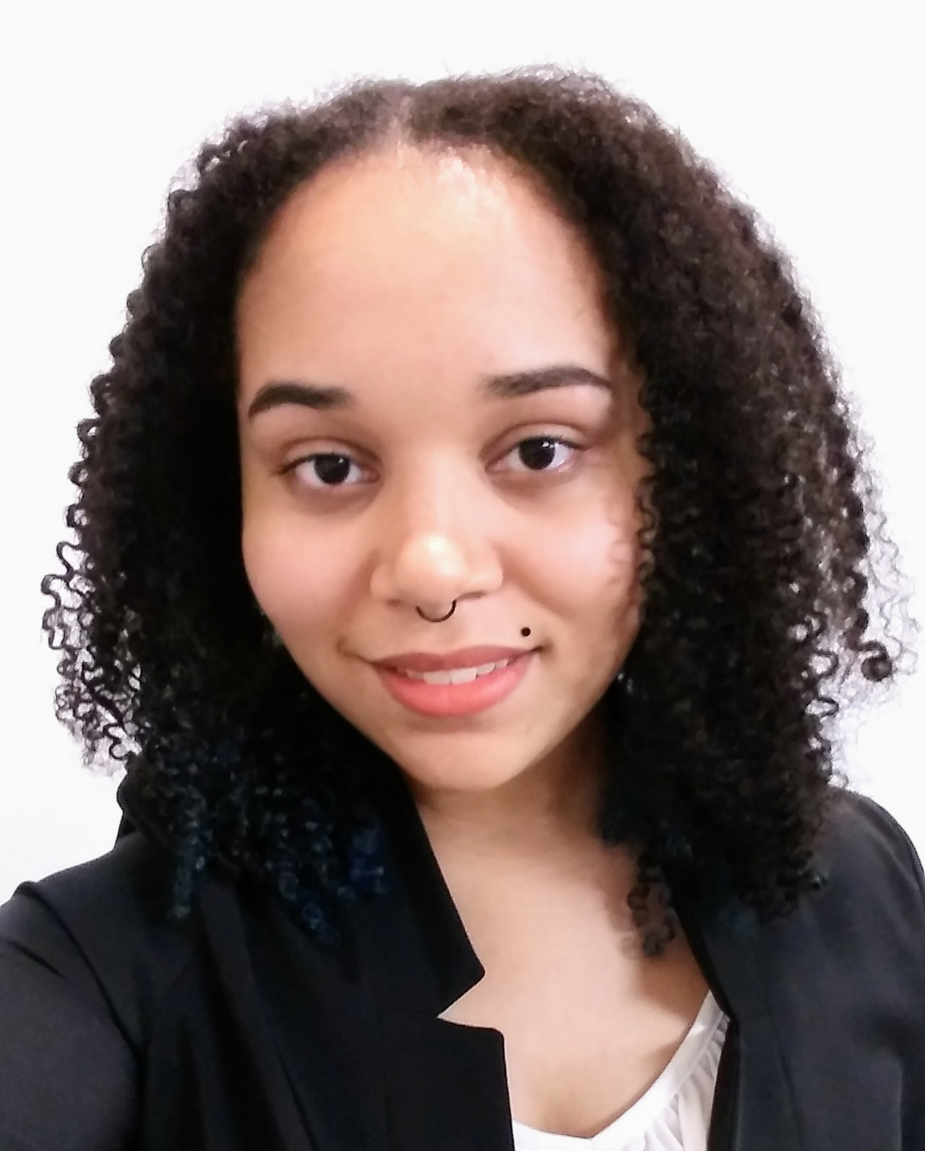
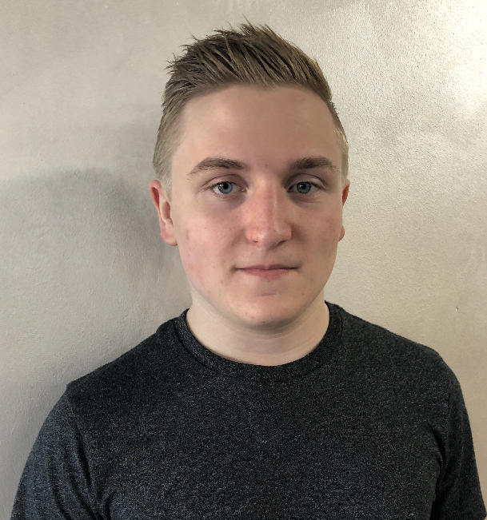
Kalob Morel Playlists Developer
Lukas Frick
Ui Developer
Martin Dampier
Documentation
Jesse Chang
Music Player Developer
LaSean Salmon
Lead Front End Developer
Gareth Bloemeke
Lead Back End Developer
Original Concept

Slide 8


Questions

